Slide 1
Infogain Certified Java Script Developer- Level 2
Part-003

Slide 2
Objective
Walking through DOM
Modifying the document
Styles and classes
Element size and Controlling
Form properties and Method

Slide 3
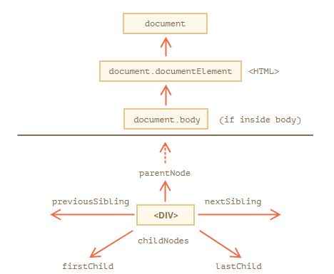
Walking through DOM
Walking the DOM
The DOM allows us to do anything with elements and their contents, but first we need to reach the corresponding DOM object.
All operations on the DOM start with the document object. That’s the main “entry point” to DOM. From it we can access any node.
Here’s a picture of links that allow for travel between DOM nodes:-

Slide 4
Walking through DOM (contd…)
The topmost tree nodes are available directly as document properties:
<html> = document.documentElement
The topmost document node is document.documentElement. That’s the DOM node of the <html> tag.
<body> = document.body
Another widely used DOM node is the <body> element – document.body.
<head> = document.head
The <head> tag is available as document.head.

Slide 5
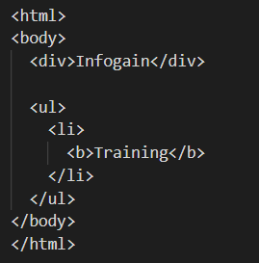
Walking through DOM (Cont.…)
Children: childNodes, firstChild, lastChild
Child nodes (or children):
elements that are direct children. In other words, they are nested exactly in the given one. For instance, <head> and <body> are children of <html> element.
Descendants:
all elements that are nested in the given one, including children, their children and so on.
For instance, here <body> has children <div> and <ul> (and few blank text nodes):
Siblings and the parent
Siblings are nodes that are children of the same parent
NOTE: You can iterate through childNodes

Slide 6
Walking through DOM (Cont.…)
More Node Types:
ELEMENT_NODE <h1 class="heading">Infogain</h1>
ATTRIBUTE_NODE class = "heading" (deprecated)
TEXT_NODE Infogain
COMMENT_NODE <!-- This is a comment -->
DOCUMENT_NODE The HTML document itself (the parent of <html>)
DOCUMENT_TYPE_NODE <!Doctype html>

Slide 7
Modifying the document
Modifying the document
DOM modification or manipulation is the key to creating “live” pages.
Here we’ll see how to create new elements “on the fly” and modify the existing page content.
To add a new element to the HTML DOM, you must create the element (element node) first, and then append it to an existing element.
Creating an element
To create DOM nodes, there are two methods:
document.createElement(tag)
Creates a new element node with the given tag:
let div = document.createElement('div');
document.createTextNode(text);
Creates a new text node with the given text:
let textNode = document.createTextNode('Here I am');

Slide 8
Modifying the document (Cont.…)
Creating the message
In our case the message is a div with alert class and the HTML in it:
let div = document.createElement('div');
div.className = "alert";
div.innerHTML = "<strong>Hi there!</strong> You've read an important message.";
We created the element, but as of now it’s only in a variable. We can’t see the element on the page, as it’s not yet a part of the document.

Slide 9
Modifying the document (Cont.…)
This set of methods provides more ways to insert:
node.append(...nodes or strings) – append nodes or strings at the end of node,
node.prepend(...nodes or strings) – insert nodes or strings at the beginning of node,
node.before(...nodes or strings) – insert nodes or strings before node,
node.after(...nodes or strings) – insert nodes or strings after node,
node.replaceWith(...nodes or strings) – replaces node with the given nodes or strings.
These methods can only be used to insert DOM nodes or text pieces.
what if we want to insert HTML “as html”, with all tags and stuff working!

Slide 10
Modifying the document (Cont.…)
elem.insertAdjacentHTML(where, html)
first parameter is a code word, specifying where to insert relative to elem.
"beforebegin" – insert html immediately before elem,
"afterbegin" – insert html into elem, at the beginning,
"beforeend" – insert html into elem, at the end,
"afterend" – insert html immediately after elem.
Give Example !!!-----------!!!

Slide 11
Styles and classes
Styles and classes
JavaScript can modify both classes and style properties.
We should always prefer CSS classes to style. The other should only be used if classes “can’t handle it”.
Remember all style and class properties accessible in script is camelCase
There are generally two ways to style an element:
Create a class in CSS and add it: <div class="...">
Write properties directly into style: <div style="...">.
For example, style is acceptable if we calculate coordinates of an element dynamically and want to set them from JavaScript, like this:
let top = /* complex calculations */;
let left = /* complex calculations */;
elem.style.left = left; // e.g '123px', calculated at run-time
elem.style.top = top; // e.g '456px'

Slide 12
Styles and classes (Cont.…)
className and classList
Changing a class is one of the most often used actions in JavaScript.
"className" property: the elem.className corresponds to the "class" attribute.
For instance:
<body class="main page">
<script>
alert(document.body.className); // main page
</script>
</body>

Slide 13
Styles and classes (Cont.…)
If we assign something to elem.className, it replaces the whole string of classes. Sometimes that’s what we need, but often we want to add/remove a single class.
There’s another property for that: elem.classList.
The elem.classList is a special object with methods to add/remove/toggle a single class.
elem.classList.add/remove("class") – adds/removes the class.
elem.classList.toggle("class") – adds the class if it doesn’t exist, otherwise removes it.
elem.classList.contains("class") – checks for the given class, returns true/false.
NOTE: classList is iterable, so we can list all classes with for..of

Slide 14
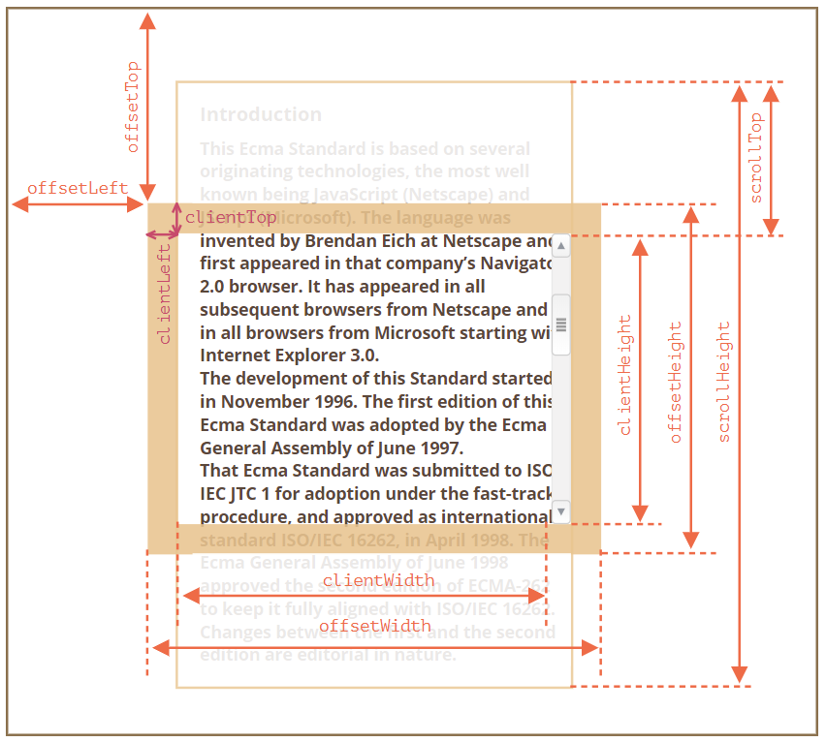
Element size and scrolling
offsetParent – is the nearest positioned ancestor or td, th, table, body.
offsetLeft/offsetTop – coordinates relative to the upper-left edge of offsetParent.
offsetWidth/offsetHeight – “outer” width/height of an element including borders.

Slide 15
Element size and scrolling
clientLeft/clientTop – the distances from the upper-left outer corner to the upper-left inner (content + padding) corner. For left-to-right they are always the widths of left/top borders. For right-to-left the vertical scrollbar is on the left so clientLeft includes its width too.
clientWidth/clientHeight – the width/height of the content including paddings, but without the scrollbar.
scrollWidth/scrollHeight – the width/height of the content, just like clientWidth/clientHeight, but also include scrolled-out, invisible part of the element.
scrollLeft/scrollTop – width/height of the scrolled out upper part of the element, starting from its upper-left corner.

Slide 16
Forms (Cont.….)
Forms and control elements, such as <input> have a lot of special properties and events.
document.forms : A form is available as document.forms[name/index].
form.elements : Form elements are available as form.elements[name/index], or can use just form[name/index]. The elements property also works for <fieldset>.
element.form : Elements reference their form in the form property.
Value is available as input.value, textarea.value, select.value etc, or input.checked for checkboxes and radio buttons.
For <select> we can also get the value by the index select.selectedIndex or through the options collection select.options.
Navigation: form and elements:
Document forms are members of the special collection document.forms, which is both named and ordered collections.

Slide 17
Forms (Cont.….)
Get form:
document.forms.employee - the form with name="employee"
document.forms[0] - the first form in the document
Get the element:
let form = document.forms.my;
form.elements.email_id; // <input name="email_id"> element
Navigation properties do not depend on the tag structure. All control elements, no matter how deep they are in the form, are available in form.elements.
There’s a shorter notation: we can access the element as form[index/name].
In other words, instead of form.elements.login we can write form.login.
But this is not recommended because when form name changes the old name methods are still accessible by form short notation.

Slide 18
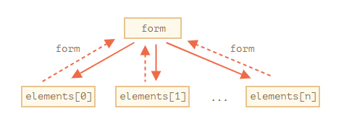
Forms (Cont.….)
Backreference: element.form
For any element, the form is available as element.form. So a form references all elements, and elements reference the form.

Slide 19
Forms Controls (Cont.….)
Form controls
input and textarea:
We can access their value as input.value (string) or input.checked (boolean) for checkboxes & radio.
input.value = "New value";
textarea.value = "New text";
input.checked = true; // for a checkbox or radio button
select and option:
A <select> element has 3 important properties -
select.options – the collection of <option> subelements,
select.value – the value of the currently selected <option>,
select.selectedIndex – the number of the currently selected <option>.

Slide 20
References
Walking through DOM : https://javascript.info/dom-navigation#on-top-documentelement-and-body
Modifying the document : https://javascript.info/modifying-document
Style and classes : https://javascript.info/callbacks
Element size and controlling : https://javascript.info/size-and-scroll
Form methods & properties : https://html.spec.whatwg.org/multipage/forms.html

Slide 21
0120 244 5144
A-16, Block A, Sector 60, Noida, Uttar Pradesh 201301

